Slide 1
SQL Security Principals and Permissions 101

Slide 2
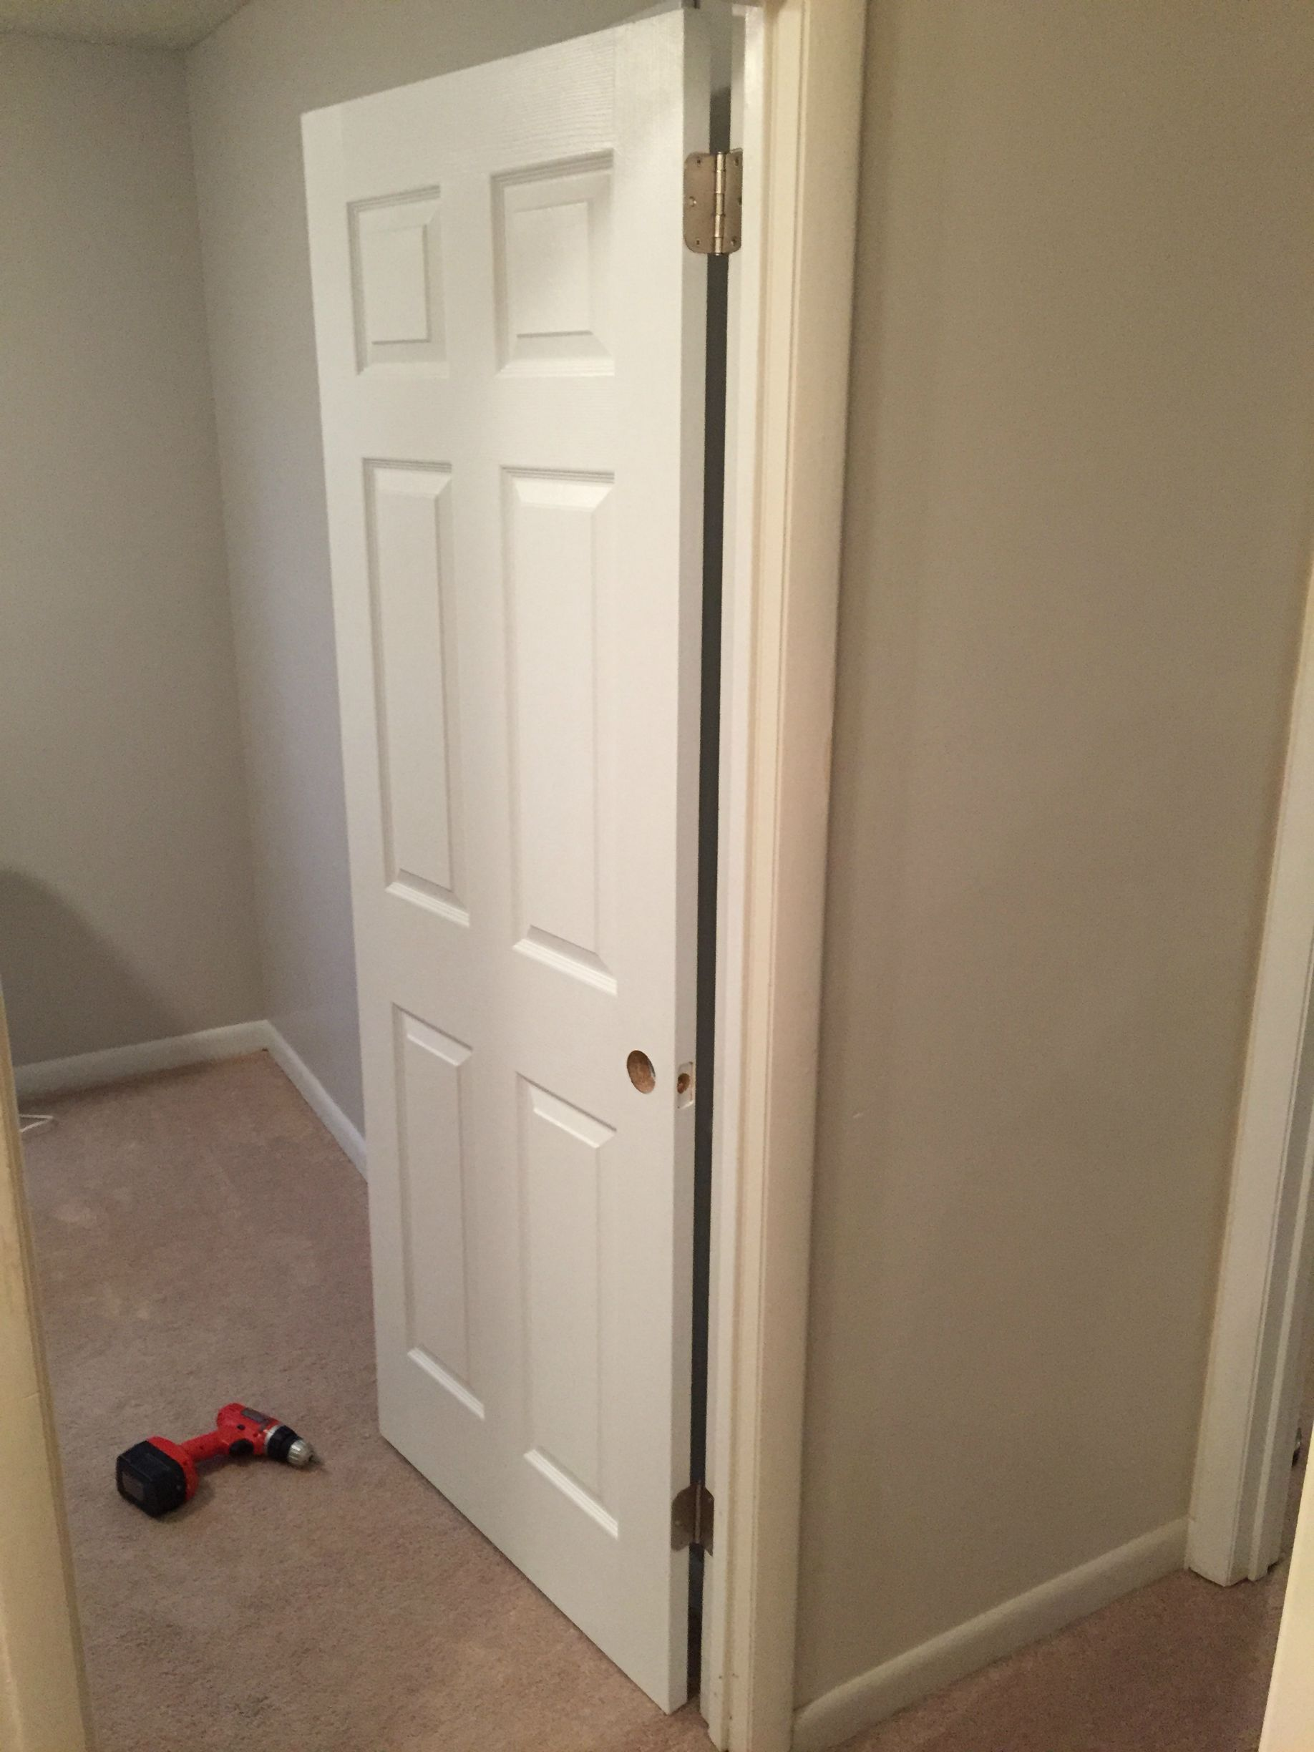

I Was Once
A Very
Crappy
Carpenter
Notes:
SLIDE PURPOSE: This is where everything starts – us defining with our customers how we can make an impact in their business regardless of the technology!
SPIEL: Technology should be transformative, not a to-do list. Because, really, just about any firm can change the way your IT works. Our mission is for IT to change the way your business works. The difference is a game-changer.

Slide 3

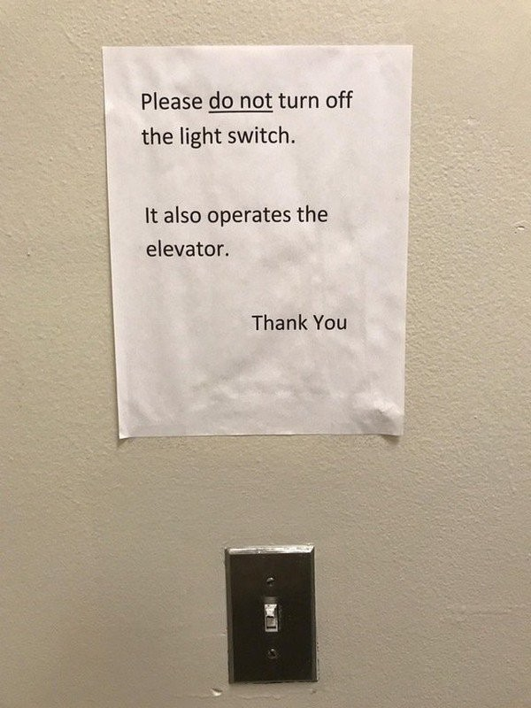
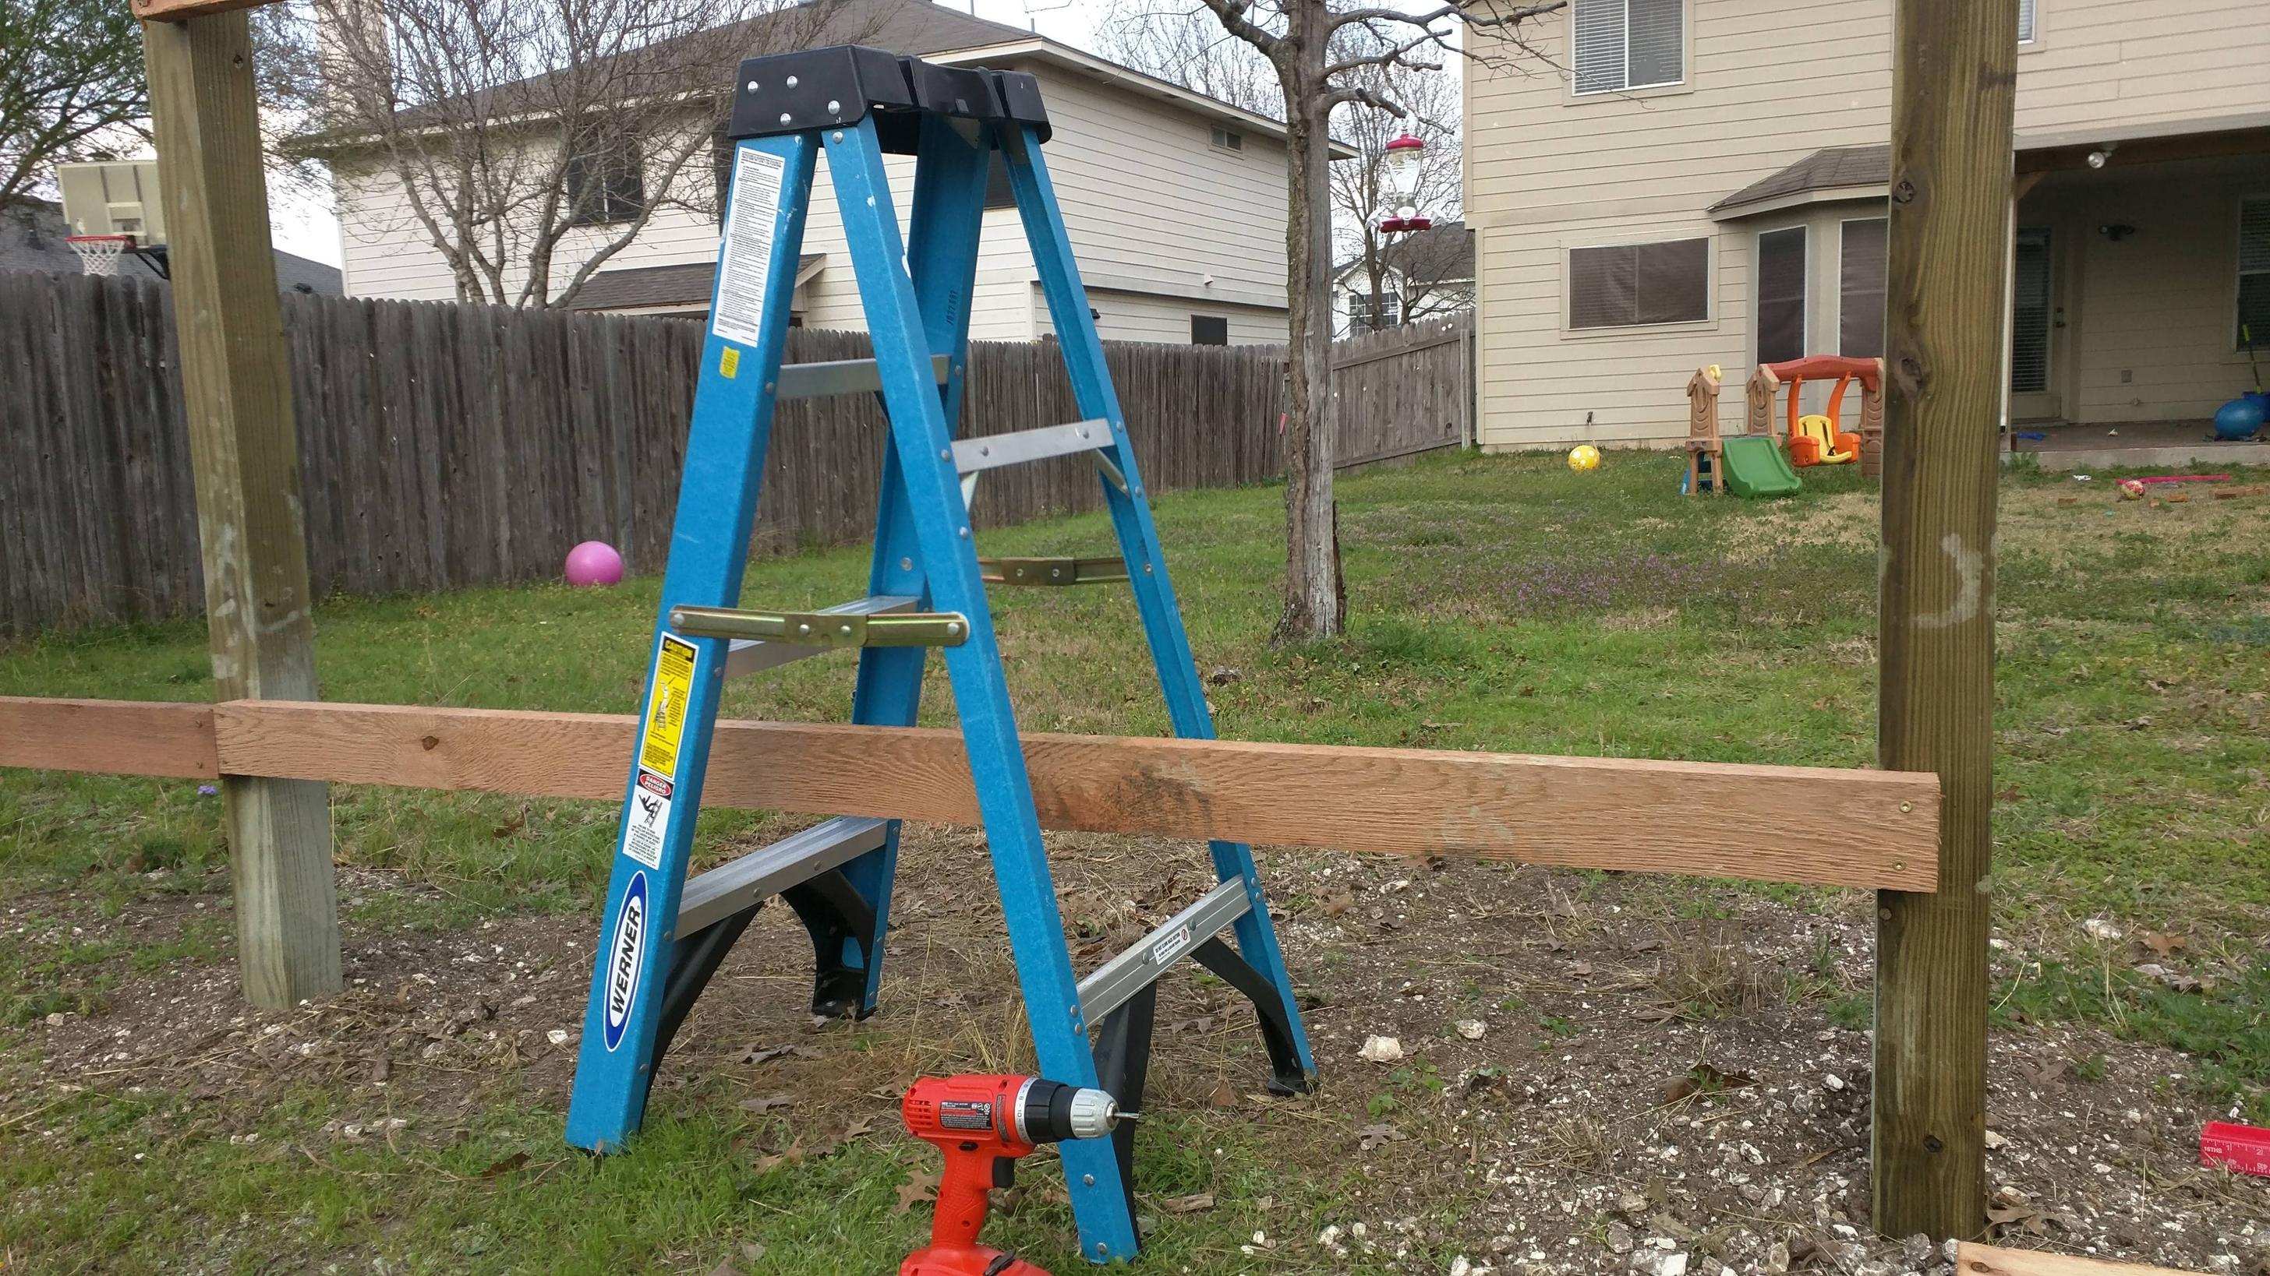
Side projects?
Interest in my work outside?
Certification exams?
User Groups and Conferences (like this)?
Nope.
Minimum effort? Yep.
Notes:
SLIDE PURPOSE: This is where everything starts – us defining with our customers how we can make an impact in their business regardless of the technology!
SPIEL: Technology should be transformative, not a to-do list. Because, really, just about any firm can change the way your IT works. Our mission is for IT to change the way your business works. The difference is a game-changer.

Slide 4

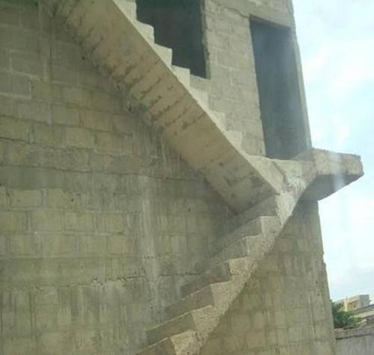

I did what I was told. I didn’t try to expand my skillset.
Video games weren’t going to play themselves, amiright?
I was just doing the job.
And I made goofs all the time
because it was just a job.
Notes:
SLIDE PURPOSE: This is where everything starts – us defining with our customers how we can make an impact in their business regardless of the technology!
SPIEL: Technology should be transformative, not a to-do list. Because, really, just about any firm can change the way your IT works. Our mission is for IT to change the way your business works. The difference is a game-changer.

Slide 5
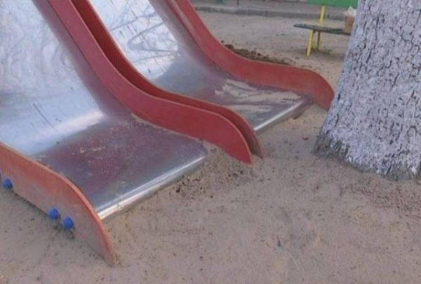

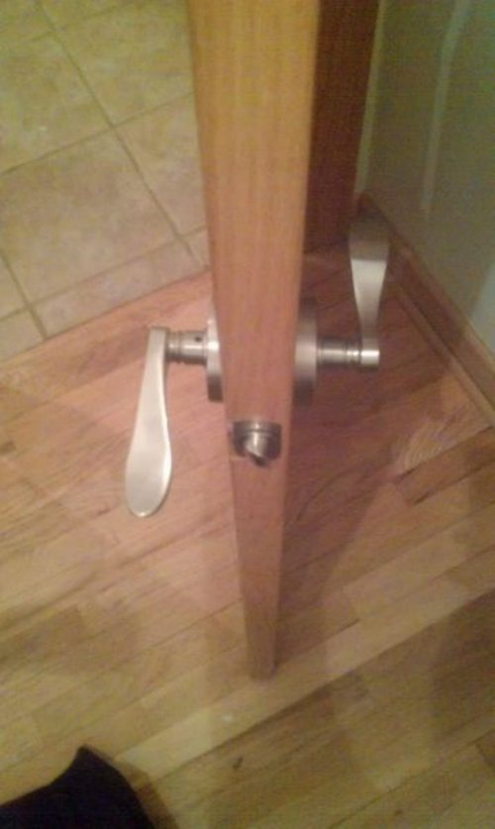
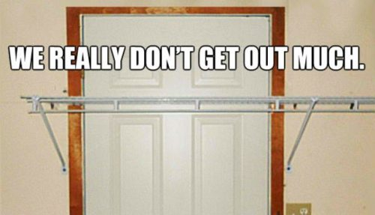
I just wasn’t very good.
I wanted be a better carpenter, I really did…
but couldn’t find time to make myself into one.
That was my employer’s responsibility...
…right?
Notes:
SLIDE PURPOSE: This is where everything starts – us defining with our customers how we can make an impact in their business regardless of the technology!
SPIEL: Technology should be transformative, not a to-do list. Because, really, just about any firm can change the way your IT works. Our mission is for IT to change the way your business works. The difference is a game-changer.

Slide 6


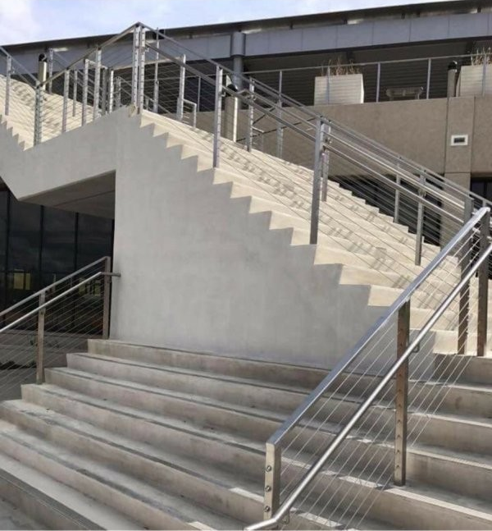
Sometimes what we want to be
and what we do at work every day
aren’t the same thing.
Who’s problem is that?
Notes:
SLIDE PURPOSE: This is where everything starts – us defining with our customers how we can make an impact in their business regardless of the technology!
SPIEL: Technology should be transformative, not a to-do list. Because, really, just about any firm can change the way your IT works. Our mission is for IT to change the way your business works. The difference is a game-changer.

Slide 7
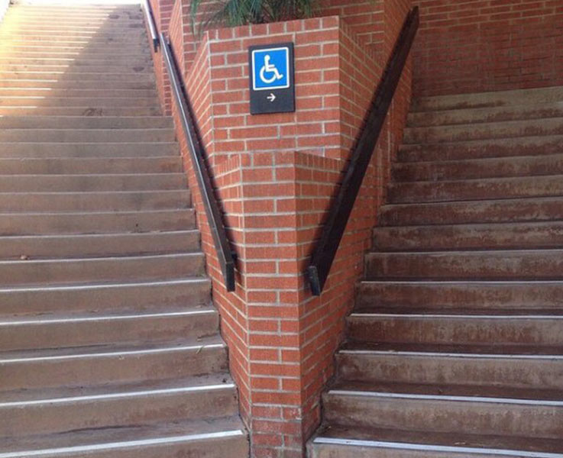
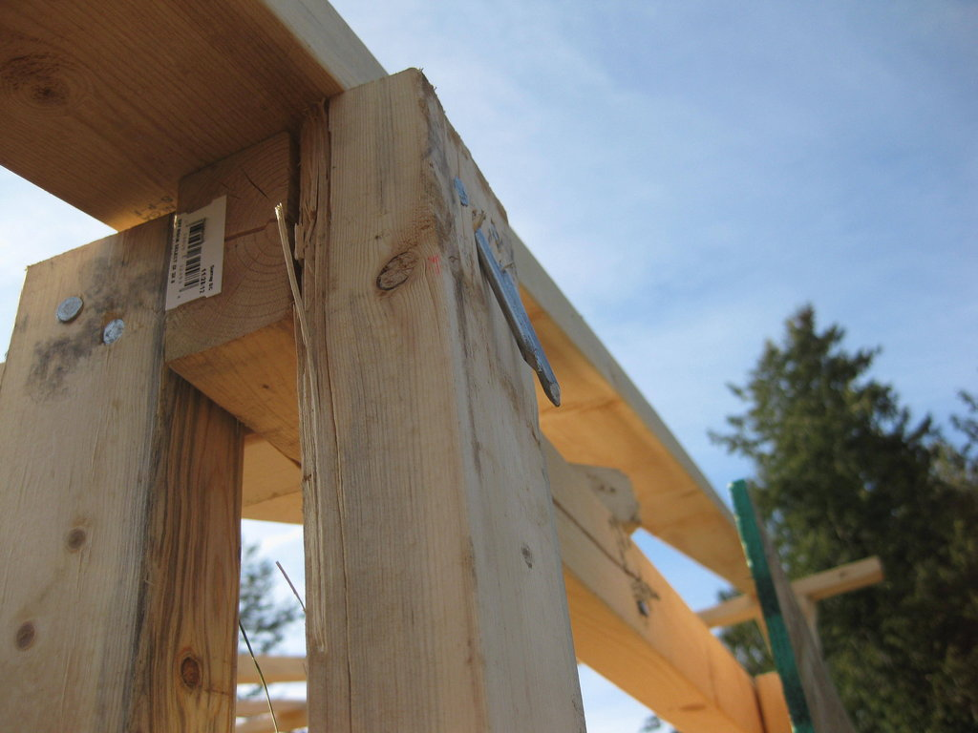
So I started studying on my own time.
I showed interest, paid more attention.
I stopped pointing out roadblocks, and started developing solutions.
I started attending local User Group events.
I created my own related side projects, even if no one ever knew about them.
Notes:
SLIDE PURPOSE: This is where everything starts – us defining with our customers how we can make an impact in their business regardless of the technology!
SPIEL: Technology should be transformative, not a to-do list. Because, really, just about any firm can change the way your IT works. Our mission is for IT to change the way your business works. The difference is a game-changer.

Slide 8
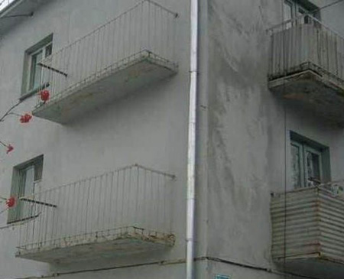


I started learning again.
Did I make mistakes?
Sure. But,
I was on the path.
Notes:
SLIDE PURPOSE: This is where everything starts – us defining with our customers how we can make an impact in their business regardless of the technology!
SPIEL: Technology should be transformative, not a to-do list. Because, really, just about any firm can change the way your IT works. Our mission is for IT to change the way your business works. The difference is a game-changer.

Slide 9
You are not [going to be] a very good “carpenter”
if your own house isn’t full of your own projects.
The only way to learn is to do.
Don’t expect to learn everything from your school or employer.
Notes:
SLIDE PURPOSE: This is where everything starts – us defining with our customers how we can make an impact in their business regardless of the technology!
SPIEL: Technology should be transformative, not a to-do list. Because, really, just about any firm can change the way your IT works. Our mission is for IT to change the way your business works. The difference is a game-changer.

Slide 10

In the Microsoft data platform field?
Join PASS (sqlpass.org). Or, join other tech orgs in your field.
Join your local User Group(s)
Go to stuff like this. Hey congrats, you’re already here!
All this stuff is really good for your professional networking!
Keep getting more involved!

Slide 11
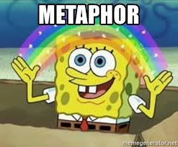
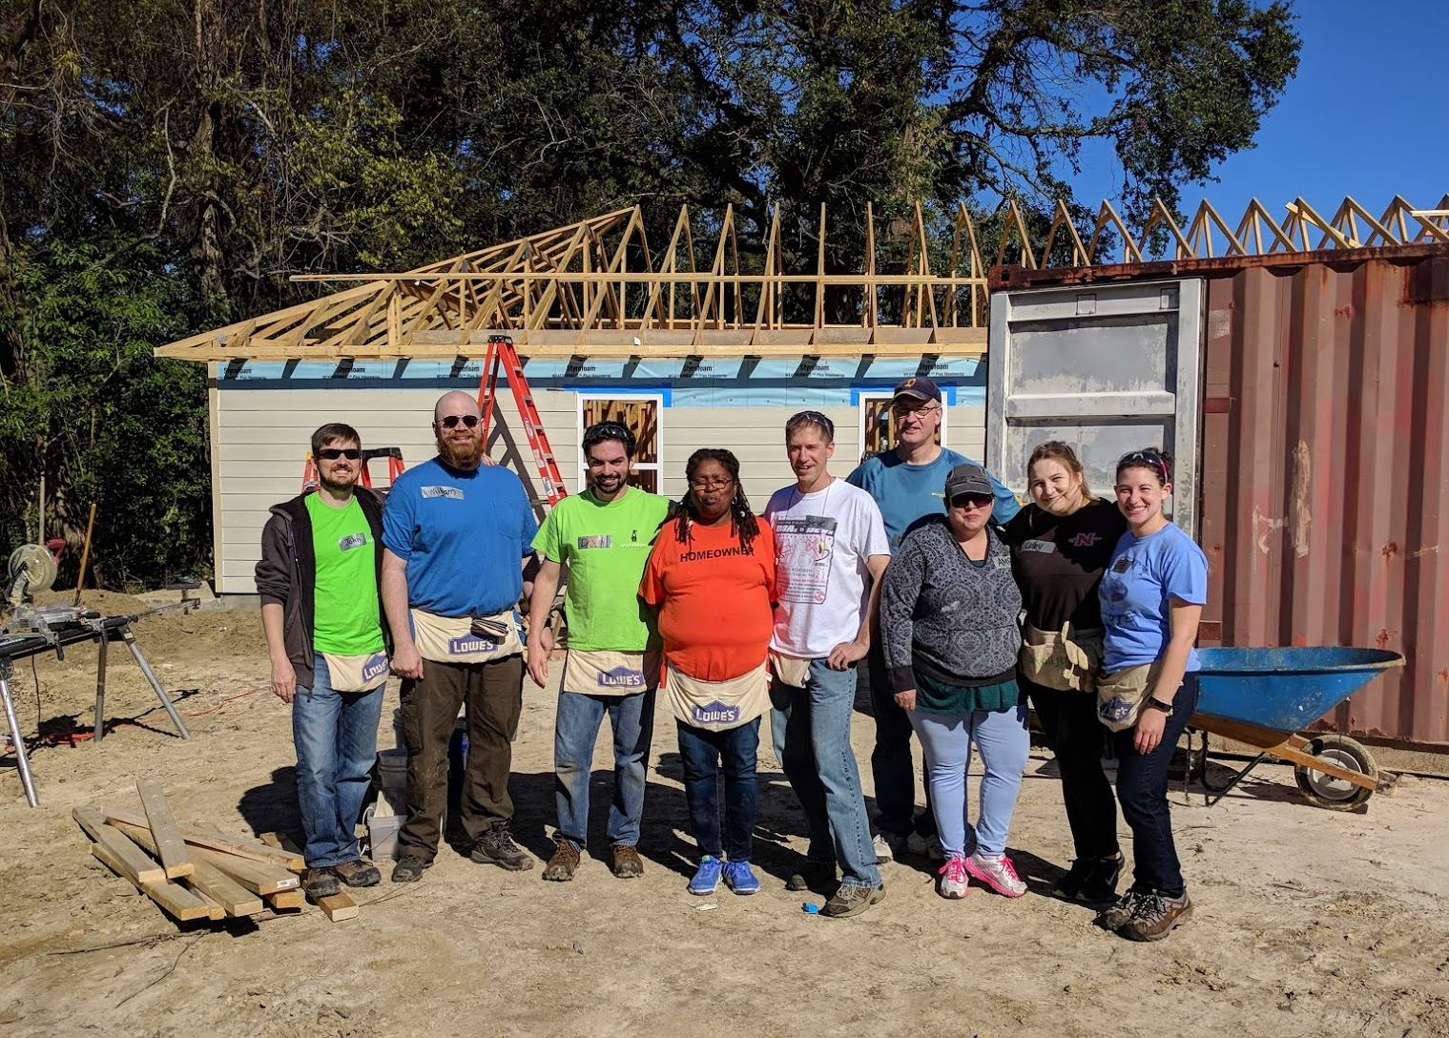
Confession Time
I’ve never actually been a carpenter.

Slide 12
I Wasn’t Really A Carpenter, But I Did Learn
Get organized. Keep getting more organized.
Take notes in OneNote, not paper. You can’t Ctrl+F paper.
Get a task list, check it.
Email hygiene is real. Clean that inbox.
Keep a calendar, if you have a partner, share your calendars. Seriously.
Personal organization ideas must be YOURS.

Slide 13
I Wasn’t Really A Carpenter, But I Did Learn
Stop fearing being wrong, start fearing becoming obsolete. Stay technical!
Learn to admit when you’re wrong, and stop wasting time covering it up.

Slide 14
I Wasn’t Really A Carpenter, But I Did Learn
4. Have a can-do attitude.
Don’t be a fault-finder.
Don’t think of roadblocks as a default method of contributing to discussion.
Start treating your colleagues like friends, not like assets or competition or frenemies.

Slide 15
I Wasn’t Really A Carpenter, But I Did Learn
Never pass up an opportunity to give a sincere "Great job!“, even to a peer.
Never ask a woman if she is pregnant.
Never ask a woman if she’s a “booth babe”.
Don’t hate.
Caffeinate Activate!

Slide 16
New Habits
New habits are like going bald.
Knew I needed to
Finally decided to
Was a shock initially, not just to me but everyone
Not everyone liked it, but they got over it
5 years later, can‘t believe I ever liked hair
I encourage you to pursue your desired habits.
“Those who do the things, do the things.”

Slide 17
Database Terminology
SQL - pronounced "sequel", not ESS KEW ELL
ANSI SQL is an international standard for Structured Query Languages.
Microsoft's database platform that is aligned with the SQL Standard is "SQL Server"
Oracle's is called "Oracle"
IBM's is called "DB2“
Others: MySQL, PostgreSQL.

Slide 18

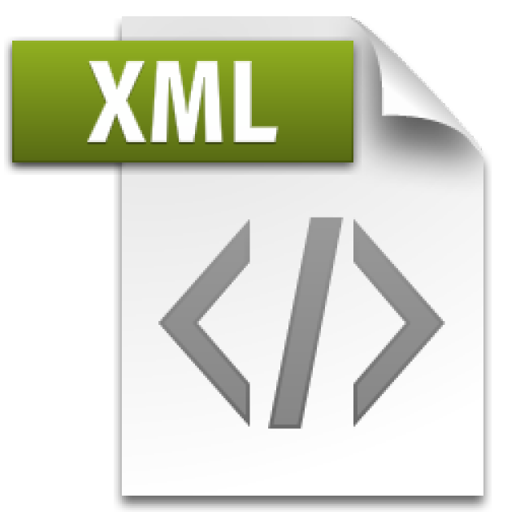
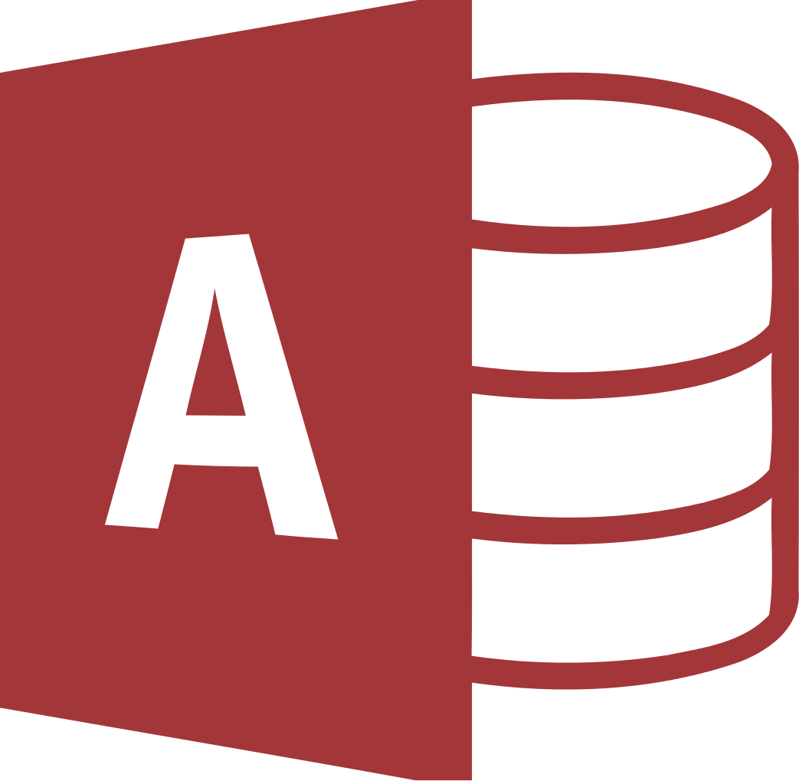
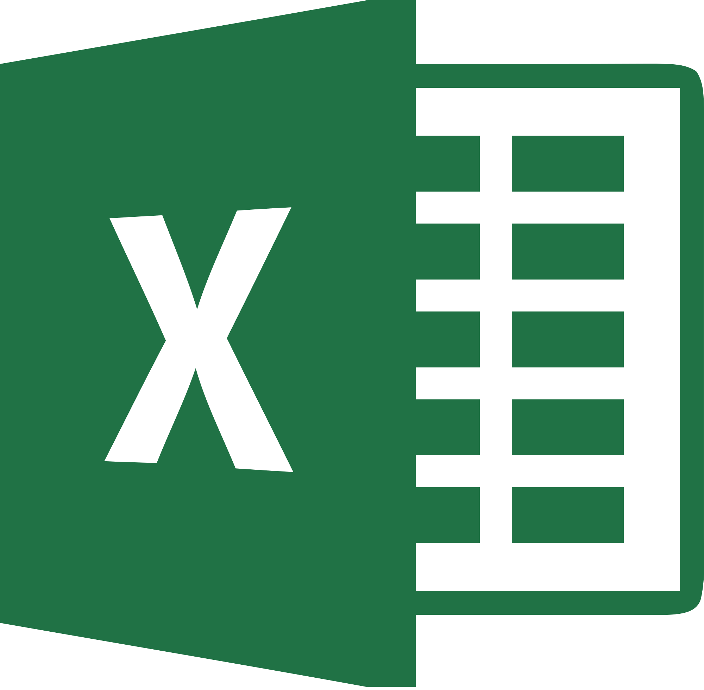
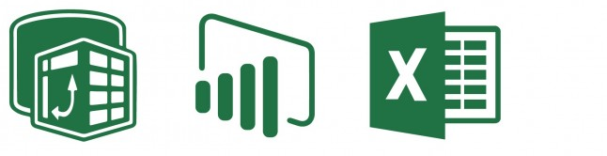

What’s Not a Database
Flat files
Including json and xml
Microsoft Access databases
Not designed for Concurrency (more later)
Excel - most popular BI tool in the world
There are dangers of "silo'ing" data
The Excel, PowerPivot, PowerBI stack
Though, valuable tools for self-service business intelligence
But not a database!
Azure Table storage

Slide 19
What’s Not a Database
Things that are NOT databases may do just fine:
Store a row for retrieval, even querying, by a user
Have data appended
Maybe even have some optional structure around data types
Things that are NOT databases are not often designed for:
Strongly-typed data validation
Multistep transactional processing, isolated updates
Disaster Recovery / High Availability
Concurrency (multiple users) and Consistency
Corruption Detection
Much more…

Slide 20
MS Access is a “Database Simulator”
Microsoft Access documentation is full of caveats about the lack of concurrency and scalability for Access.
The 32-bit "Microsoft Jet [the database engine inside Access] can only handle a limited number of sessions."
"...when multiple concurrent users make requests of a Microsoft Access database, unpredictable results may occur."
"...it was not intended (or architected) for high-stress performance..."

Slide 21
What is a Database
Products like Microsoft SQL Server (and Azure SQL DB)
Competitors: Oracle, MySQL, PostgreSQL, IBM DB2, SQLite
All follow some implementation of a universally accepted standard language for data platforms:
SQL – “Structured Query Language”
SELECT … FROM … WHERE …
Microsoft’s implementation = TSQL
Oracles implementation = PLSQL
Basics are same, but many important vendor-specific features are nonstandard, not interchangeable, require cross-training

Slide 22
ACID Compliant Databases
Atomic
A transaction is all or nothing
Consistent
Transaction brings the entire database from one state to another - not just a single part of the database
Eventual consistency can be useful - Cassandra, MongoDB, Redis
Isolated
Transactions, though handled concurrently, are still processed sequentially and independently
Incomplete transactions should not be visible to other transactions
Durable
If the power goes off, the data is still there. It's not stored in volatile memory.

Slide 23
NoSQL
NoSQL isn’t a product, it’s a category, similar to “Big data”
Big data storage: Apache Hadoop, Azure Blob Storage, Spark
NoSQL platforms: RavenDB, MongoDB, DynamoDB.
Amazon, Facebook, Google have their own platforms
There are vendors who have specialized in it all along
Twitter originally used Cassandra, now they use their own “Twitter-scale” distributed database platform, Manhattan

Slide 24
NoSQL
One of the characteristics (and common use cases) of a NoSQL database is eventual consistency.
Twitter cannot commit a transaction globally, synchronously
Your hot taek tweet takes some time to propagate globally through the distributed database system
Other aspects of ACID may be violated in name of performance, and as long as the devs are aware, it’s OK.
This would be completely unacceptable for:
A stock exchange (NASDAQ – runs on MS SQL Server)
A sportsbook (Bwin – runs on MS SQL Server)

Slide 25
NoSQL
Microsoft isn’t without NoSQL offerings:
PolyBase is a feature inside MS SQL to query big data in Hadoop or Azure Blob storage with TSQL
Many different MS SQL features that break ACID
CosmosDB –new planet-scale database platform
This presentation focuses on MS SQL Server

Slide 26
PaaS
MS SQL Server is installed, configured, maintained
What if there was an offering that provided everything for you, automated, without maint?
Platform-as-a-Service
An instance of a database is created for you, with easy UI to interact, no maintenance, backups, storage config needed
Scalable – change CPU/memory/storage capacity on the fly
Examples: Azure SQL DB, Amazon RDS
Infrastructure-as-a-Service
Here’s a VM. Have fun. But you don’t have to worry about the network layer, redundant power, physical disks. Also scalable.

Slide 27
How to get SQL Server - Editions
This is the link to download SQL for FREE:
Do a web search: “SQL Server 2019 Download”, click Developer Edition
Free editions of SQL: Developer, Express

Slide 28
How to get SQL Server - Editions
Developer is same as Enterprise, but cannot be used in production.
Standard edition is not free, but is roughly 20% the $ of Enterprise.
Express has no agent, can’t back itself up, very limited. Not appropriate for production.

Slide 29
How to get SQL Server - Tools
The tools to dev in the Microsoft ecosystem are all free, just do a web search:
SSMS (for the SQL Server)
SSDT (for SSRS, SSIS, SSAS, also for Database Projects) (installs a shell of Visual Studio)
Visual Studio Community Edition or Visual Studio Code

Slide 30
Accessing your SQL Server
Now that it is installed, how do you log in to it?
During install, you’re given a chance to:
Add initial administrators. Use your domain account (if applicable) or local windows user, or a Windows/AD security group that you are in.
If you activate SQL Authentication, provide a password for the ‘sa’ login.
Heads up – avoid using ‘sa’ whenever possible, especially not in your apps!!
Use Windows Auth whenever possible.

Slide 31
Why is SECURITY important?
Proper implementation of SQL security principals:
Decreases administrative effort
Decreases application complexity
Decreases database surface area
Listen during this presentation for real-world applications, and feel free to ask questions.
Blog where this can be downloaded: SQLTact.com
Toolbox: github.com/sparkhoundsql/sql-server-toolbox

Slide 32
Login vs usEr
Database User
Sets a database context
Linked to a Server Login
Does not have a password
Stored in the User Database
Included in User DB Restore
Given access to SELECT, UPDATE, EXECUTE, CREATE TABLE
Server Login
Connects to a SQL Server
Can be linked to AD (Windows)
or have a password (SQL)
Stored in the Master database
Not affected by User DB Restore
Given access to RESTORE, CONNECT, CREATE DATABASE

Slide 33
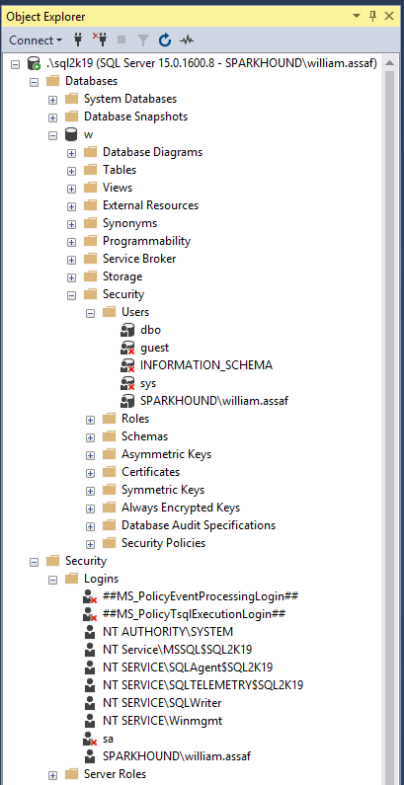
LOGIN VS USER
Database User
Sets a database context
Linked to a Server Login
Does not have a password
Stored in the User Database
Included in User DB Restore
Given access to SELECT, ALTER, EXECUTE, CREATE TABLE
Server Login
Connects to a SQL Server
Can be linked to AD (Windows) or a password (SQL)
Stored in the Master database
Not affected by User DB Restore
Given access to BACKUP, RESTORE, CONNECT, CREATE DATABASE

Slide 34
On the topic of Groups…
Always assign permissions to AD groups, insist on it.
BUT
Be aware of who is a member of those groups, and what groups are a member of groups, and what groups are a member of those groups…
Devs -> App Support -> QA -> Financial Analysts…

Slide 35
On the topic of Groups…
You can interrogate AD for the members of security groups
EXEC master..xp_logininfo
@acctname = 'domain\groupname',
@option = 'members'
BUT it only returns FIRST level members, not members of groups that are members of the group. Instead use PowerShell:
Get-ADGroupMember -identity 'Development' -recursive

Slide 36
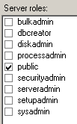
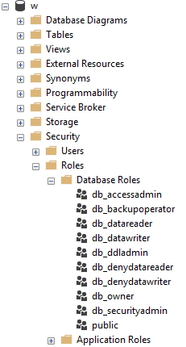
Roles
Roles are security principals that can grant permissions to other security principals.
Logins are added to Server Roles
Users are added to Database Roles
Built-in Roles to provide a standard for access.
Instead, assign more specific permissions when possible. Your data may not be homogenous in terms of sensitivity/permissions to access.

Slide 37
PUBLIC
Every login/user is a member of “public” roles.
Public is a server role that should never be granted any additional permissions, authorization or ownership.
Every database user/roles belongs to a public database role.
When a user has not been granted or denied specific permissions on a securable, the user inherits the permissions granted to public.

Slide 38
PUBLIC
Check for this.
Toolbox: public permissions.sql
Permissions assigned to the public role is a clear sign of lazy developers. Don’t be a lazy developer.
Should fail any security audit.
The strategy to undo a security architecture based around public can be complicated, involves lots of testing.

Slide 39
GUEST
Check for this.
Toolbox: guest permissions.sql
The GUEST account permissions are granted to any login who does not have a mapped user in the database.
For what should be very obvious reasons, never grant any permissions, even CONNECT, to GUEST, unless you understand what you’re doing.
Not a secure solution for future access.

Slide 40
Logins
A SQL Server Login is a server-level security principal
A User is a database-level principal
Logins are given a default database.
CONNECT will fail if the Default Database is not accessible.
Best practice: set Default Database to the intended User Database, or to TempDB, which is always there, but not persistent.

Slide 41
Logins vs users
Remember, a Server Login is what authenticates a user connection to the SQL Instance.
A Database User provides a Login with database access.
“Login” is a server level security principal.
“User” is a database level security principal.

Slide 42
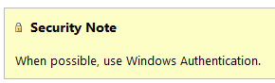
Sql logins
SQL Logins are authenticated by SQL Server.
Strongly encouraged to Enforce password policy, which can include password expiration, inheriting from the same settings in Windows.
Unfortunately, the password policy is optional!
Multiple failed SQL auth login attempts will Lock Out, which a DBA must resolve.

Slide 43
Windows vs SQL Auth
Remember, a Login is what authenticates the user to the SQL Server instance, not a User.
In a typical business environment,
Windows Authentication means that
account creation/termination,
security group membership,
password policy,
are all handled by an existing corporate security administration infrastructure.

Slide 44
Windows vs SQL Auth
Windows Authentication is the default security model for SQL Server, by default the only security model, and cannot be disabled.
Choosing Mixed Mode as a server option enables SQL Logins and allows the “sa” account to be enabled.

Slide 45
Apps + windows auth
The Windows Authentication model creates Server Logins that are linked to Local Windows or Domain Accounts
Preferably linked to AD Security Groups, not individuals, so this membership is also managed by your existing security infrastructure.
From an Internet-facing server, Kerberos may be required to authenticate a Windows User directly from the application server to the SQL Server.
Can increase the complexity of an application loadout, but this is the Enterprise approach.

Slide 46
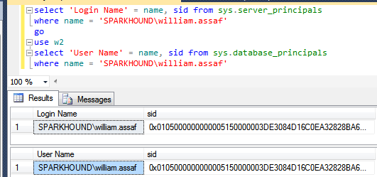
Logins + users
A User can be linked to any Server Login – the names don’t actually have to match.
A SID (Security-IDentifier) is shared by User and Login.

Slide 47
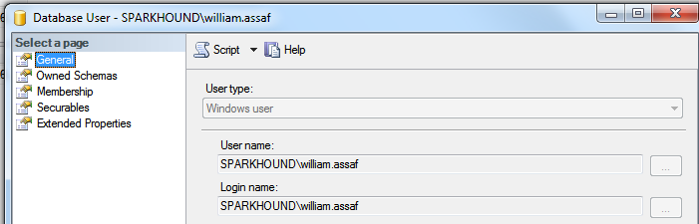
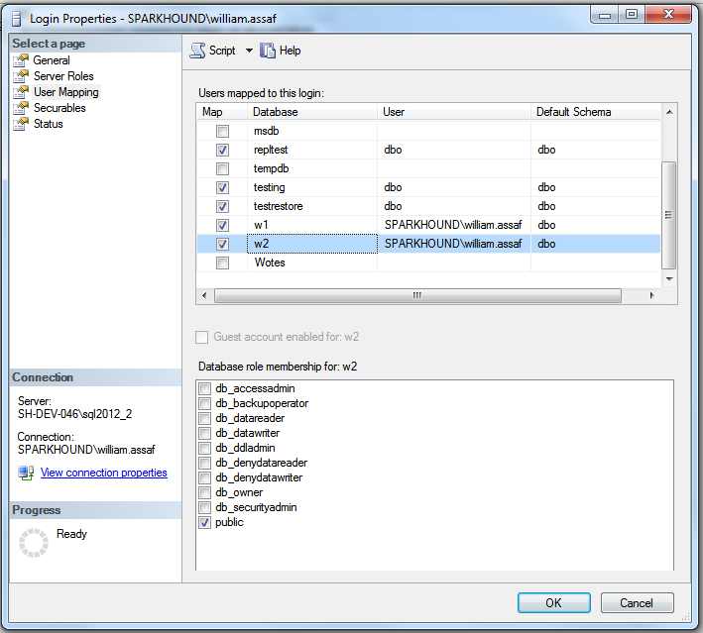
User MAPPING
Logins are mapped to Users in the User Mapping page of the Login properties dialog.

Slide 48
Orphaned sid
SQL Auth Logins can become disconnected from their Database Users when a database is restored from another server.
Only occurs with SQL Authenticated Logins, not Windows Authenticated Logins
Commonly occurs when a database is restored from one server to another
To re-associate a database user to a server login:
ALTER USER username WITH LOGIN = loginname;

Slide 49
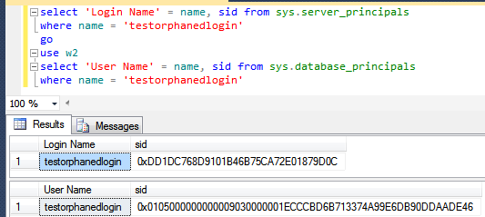
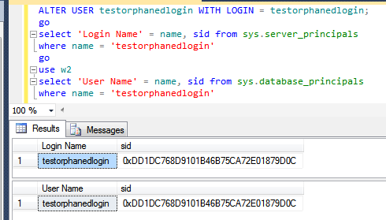
Fix orphaned sid
Fix: SQL Auth Login becomes disconnected from its User
Toolbox: fix orphaned sid.sql

Slide 50
Sql login migration
Not possible to reverse-engineer a SQL Auth Login password.
When migration applications from one SQL Server instance to another, migration of SQL Logins is accomplished by:
Backup+restore of the master database (complicated) -OR-
Creating SQL Logins with same SID but new password (not desirable) -OR-
Generating a hash of the password and same SID (most desirable) Let’s go more into that….

Slide 51
Sql login migration
Microsoft has provided a pair of sprocs to generate the hash of passwords: support.microsoft.com/kb/918992
sp_hexadecimal + sp_help_revlogin
But don’t forget to migrate the server-level permissions:
Toolbox: security Script servers.sql

Slide 52
Sql login SIDS
Creation of the SQL Login with its existing password AND SID is critical.
This is also important for setting up new Availability Groups, as the Login SIDs must match on every replica.
A regular proactive check for all SQL Server instances in Availability Groups:
Check that all SQL Logins exist
AND they have the same SID, not just same NAME

Slide 53
Contained databases
Not very common architecture but notable.
Moves authentication from the Server level directly to the Database level.
A contained database owner, for example an Application owner, has full control over security in the database.
No server-level (or sysadmin) permissions necessary
Contained database has no configuration dependencies on the instance, it can be easily moved to another instance.

Slide 54
Contained databases
In SQL Server, Authentication can be made with Windows Auth logins or Contained Database Users where the password is maintained inside the database.
Agent jobs, system error messages, linked server information, and system settings are all inside the contained database instead of master or msdb.

Slide 55
Contained databases
What this means is that this syntax, which heretofore made no sense, on a contained database is perfectly valid:
USE [SomeUserDatabase];
CREATE USER BI_User WITH PASSWORD ='strongpassword';

Slide 56
Contained databases
A database platform where all the major necessities for authentication and system objects are stored in the user database…
No system databases needed, so the database is easily portable between servers…
What does this sound like?
Azure SQL Database!

Slide 57
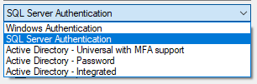
Azure SQL DB
Additional types of authentication since SSMS 2016
“Active Directory” options used for Azure AD only

Slide 58
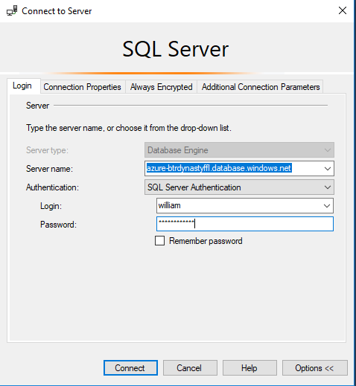
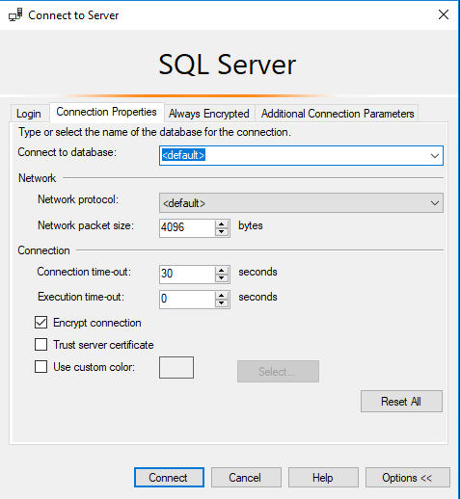
Azure SQL DB
Only real caveat when connecting to an Azure SQL DB: You youths can’t use USE, you must set the context at login.

Slide 59
Azure SQL DB
You can use Azure Active Directory accounts only for Azure SQL contained database users, but not for Azure SQL server logins. Example: in [SomeUserDatabase]
CREATE USER [reportuser@domainname.onmicrosoft.com] FROM EXTERNAL PROVIDER;
Only Active Directory accounts can create other Active Directory accounts in Azure SQL Database. You add the first via the Azure Portal.

Slide 60
Azure SQL DB
Otherwise, most (not all) permissions, objects, schema operate the same on Azure SQL Database, Azure SQL Managed Instance (MI), SQL Server, and SQL Server on Linux.
In this presentation when we’re talking about permissions, stored procs, views, functions, it’s the same for any platform.

Slide 61
A BIT ON Connection providers
OLEDB was un-deprecated, re-released in ‘18. https://blogs.msdn.microsoft.com/sqlnativeclient/2017/10/06/announcing-the-new-release-of-ole-db-driver-for-sql-server/
Install and Convert your OLEDB connection strings from sqlncli11 or sqloledb, to the new MSOLEDBSQL.
There is also a relatively new ODBC Driver 17 for SQL Server. https://techcommunity.microsoft.com/t5/SQL-Server/ODBC-Driver-17-for-SQL-Server-Released/ba-p/385825
Both replace the OLEDB/ODBC functionality of the SQL Native Client (SNAC) which is no longer maintained.
New OLEDB or ODBC can connect to SQL on-prem and Azure
Important to update sqlncli10 for Availability Groups
https://www.sqltact.com/2019/06/actual-emails-will-msoledb-work-for.html

Slide 62
Basic user permissions
DML*
SELECT
DELETE
UPDATE
INSERT
REFERENCES
*Data Manipulation Language
DDL**
ALTER
CONTROL
VIEW DEFINITION
CREATE
DROP
EXECUTE **Data Definition Language
Modify Security
GRANT
REVOKE
DENY
IMPERSONATE

Slide 63
USEFUL permissions
Commonly requested permissions for non-sysadmins
ALTER TRACE For SQL Profiler and traces
ALTER ANY EVENT SESSION For XEvents (better than traces!)
VIEW SERVER STATE For server-level DMV’s, XEvents
VIEW DATABASE STATE For database-level DMV’s
VIEW ANY DEFINITION For definitions of objects
These permissions are given by the GRANT syntax GRANT VIEW SERVER STATE TO [SPARKHOUND\william.assaf];
_____________________________________________________
GRANT VIEW SERVER STATE TO [SPARKHOUND\DBATeam];

Slide 64
Basic user permissions SAMPLE SCENARIO
GRANT SELECT ON game.PingPongScores TO [PINGPONG\FGump];
GRANT EXECUTE ON game.spGetScore TO [PINGPONG\FGump];
GRANT EXECUTE TO [PINGPONG\FGump]; --in current db context
GRANT VIEW DEFINITION ON game.spGetScore TO [PINGPONG\FGump];
GRANT ALTER ANY EVENT SESSION TO [PINGPONG\FGump];
GRANT VIEW SERVER STATE TO [PINGPONG\FGump];

Slide 65
More USEFUL permissions
SHOWPLAN Viewing execution plan for executable query
IMPERSONATE Allows testing as another user
CONNECT ALL DATABASES Allows the login to set any database context (USE) but grants no other rights in each database, potentially appropriate for day-to-day accounts
SELECT ALL USER SECURABLES SELECT from all objects in ALL db’s, potentially appropriate for day-to-day accounts

Slide 66
GOTTA KEEP EM SEPARATED
All Administrators (including DBA’s) should have two accounts: one for day-to-day workstation/email access, one for production admin-level access.
Day-to-day accounts may have read-only access to non-sensitive databases, including system metadata, job status, logs, etc.
The same domain accounts that have production access should not have VPN/remote access.

Slide 67
CONTROL permissions
CONTROL SERVER Effective the same as sysadmin. Not for non-admins.*
CONTROL DATABASE Effective the same as db_owner. Not for non-admins.*
*One minor difference. CONTROL permissions can be affected by DENY, but sysadmin/db_owner cannot.
Let’s demonstrate…

Slide 68
Testing Permissions with EXECUTE AS
USE [master];
CREATE LOGIN [domain\username] FROM WINDOWS;
GO
GRANT CONTROL SERVER TO [domain\username];
DENY VIEW SERVER STATE TO [domain\username];
GO
EXECUTE AS LOGIN = 'domain\username';
SELECT * FROM sys.dm_exec_cached_plans; --Fails
GO
REVERT; --Reverts the EXECUTE AS
GO
Notes:
While the sysadmin role is unaffected by any DENY permissions while the CONTROL SERVER permission is. CONTROL SERVER is needed to access sys.dm_exec_cached_plans, a server-level DMV for reviewing plans in cache.

Slide 69
Testing Permissions with EXECUTE AS
EXECUTE AS makes it possible for you to simulate the permissions of another principal in your current session.
Always follow an EXECUTE AS with a REVERT, which stops impersonation. A REVERT affects only one EXECUTE AS.
During testing, display what principal you are:
SELECT ORIGINAL_LOGIN(), CURRENT_USER;
ORIGINAL_LOGIN() The name of the login with which you actually connected. This will not change even after you use EXECUTE AS USER or EXECUTE AS LOGIN.
CURRENT_USER. The name of the user you have assumed.

Slide 70

SQL INJECTION
https://xkcd.com/327/

Slide 71
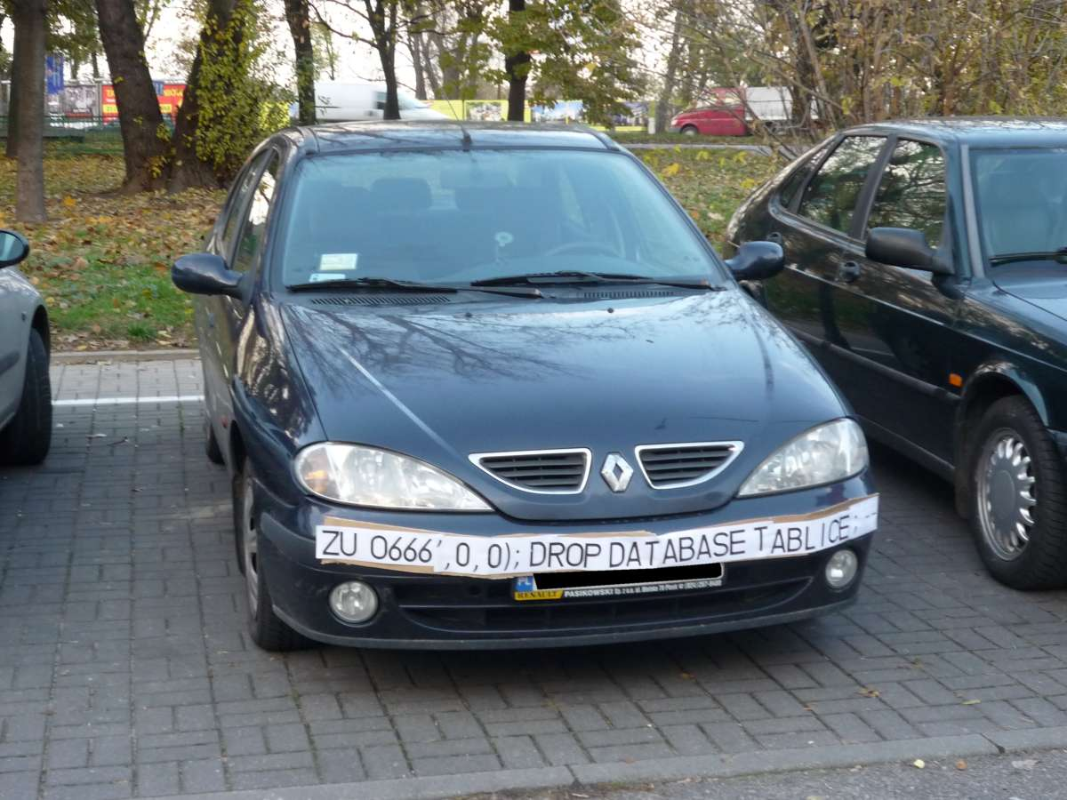
SQL INJECTION

Slide 72
SQL Injection
This is a much larger topic with lots of info out there.
SQL Server is better than some RDBMS platforms but is not immune to SQL Injection attacks made possible by security-ignorant development.
Developers must be aware of SQL Injection-blocking patterns on public websites:
Parameterize the input from the website (use sprocs!)
Sanitize inputs of special characters
Don’t run websites logins with more databases permission than needed (again, use sprocs!)

Slide 73
what can you do to prevent SQL Injection?
Design tables with appropriate data types and lengths.
Insist on stored procedures for public-facing operations like searches. Be aware of what db’s have public apps.
Insist on stored procedures for Entity Framework (or other ORMs) operations involving 2+ entities.

Slide 74
what can you do to prevent SQL Injection?
Avoid apps running with permissions like the db_datareader and db_datawriter roles, and certainly not db_owner.
Avoid the use of EXECUTE AS in code, which could allow injected code to execute with elevated security.
Train devs on patterns of stored procedure parameter sanitizing. Never use EXEC() or sp_executesql with user-enterable data.

Slide 75
what can you do to prevent SQL Injection?
Provide links, attention, and visibility to PM’s and Dev’s for SQL Injection awareness.
Lobby for penetration testing and SQL Injection detection tasks in sprints.
With Azure SQL DB, enable Azure Threat Detection!

Slide 76
AZURE threat detection
Azure SQL Database Threat Detection is a security intelligence feature built into the Azure SQL Database, activated with a button click.
Detects potential vulnerabilities such as Potential SQL Injection attacks, brute force attacks, anomalous login patterns, and more.

Slide 77
Feature Restrictions
Azure SQL Database and SQL Server 2019 have a pair of minor anti-injection feature to disable a pair of common probing attacks.
An injection attack will use delay or error messages to probe for vulnerabilities. An Error Message could contain object names.
You can disable WAITFOR and all error messages for a database user or role. For example:
EXEC sp_add_feature_restriction N'ErrorMessages', N'User', N’WebUser’
EXEC sp_add_feature_restriction N’WaitFor', N'User', N’WebUser’
Bypassed if running your website as a sysadmin or db_owner!
Learn more: https://docs.microsoft.com/en-us/azure/sql-database/sql-database-feature-restrictions

Slide 78
SSMS Vulnerability Assessment
Built into SSMS, there is a Vulnerability Assessment tool available via Object Explorer in each Database -> Tasks.
Introduced in SSMS 17.4 in SQL 2017.
Many findings have to do with database-level permissions that we’re discussing today: PUBLIC, GUEST, user-defined roles, low-impact roles, orphaned roles, least privilege, and more.

Slide 79
Stored procedures
Stored procedures require EXECUTE to run, and do not require all underlying object permissions (SELECT, INSERT, DELETE)…
…provided that the sproc doesn’t perform IDENTITY_INSERT on a table, which requires ALTER permissions not abstracted.
…provided that all the underlying objects have the same ownership chain.
…provided that the stored procedures do not use dynamic sql commands exec sp_executesql @SQL or EXEC(@SQL)

Slide 80
Stored procedures
Given those conditions, thanks to the database permission chain, you can:
GRANT EXEC rights to sprocs that INSERT UPDATE and SELECT from a table.
GRANT no other permissions to the table!
The user can read data in the table using the sproc ONLY.

Slide 81
Stored procedures
Consider DENYing SELECT rights to the public role, which is inherited by all user roles aside from db_owner and sysadmin.
Users prevented from accessing any tables or views directly from any application (SSMS, Access, Excel!).
User access to data is forced through sprocs. (Good!)

Slide 82
Views
Similar to stored procedures, a VIEW will allow a user to SELECT data from tables to which the user does not have access. (This is helpful!)

Slide 83
User-Defined Functions (UDF)
Similar to stored procedures, a UDF will allow a user to SELECT data from tables that the user does not have access to.
Keep in mind the performance impact of functions can be severe, especially in the SELECT portion of a query.
Overuse of UDF’s are common causes for performance issues. High potential for cursor-like effects.

Slide 84
laB
Demonstrate how Stored Procedures, Views, and Functions abstract the permissions necessary to view underlying table data.
Toolbox\Security p1.sql – logged in as sysadmin
Toolbox\Security p2.sql – logged in as testing user

Slide 85
Builtin\administratorS
Prior to SQL 2008, [BUILTIN\Administrators] was a member of the SQL sysadmin role.
This was a security hole – allowing anyone who gained admin access to a Windows Server to automatically and easily have sysadmin access.
SQL 2008 – BUILTIN\Administrators no longer have automatic rights to the SQL server and should NOT be granted access.

Slide 86
dbo
In SQL 2000, sales.dbo.customers meant:
databasename = sales
owner = dbo
tablename = customers
In 2005 and later, sales.dbo.customers meant:
databasename = sales
schema = dbo
tablename = customers

Slide 87
dbo
In SQL 2000, dbo was a special user inside each database with sysadmin permissions, which by default owned any object created by an admin.
In SQL 2005 and above, dbo is the default schema and no longer a security object. Saying a user has “dbo permissions” is incorrect.
[db_owner] is just a user role with no server-level permissions.

Slide 88
ownership
Microsoft has done away with the terminology of Users or Logins “owning” objects, such as databases and schemas.
Changing the AUTHORIZATION is now the more accurate term to describe “ownership” of an object.
For example, sp_changedbowner is deprecated, replaced by ALTER AUTHORIZATION

Slide 89
Schemas
A schema is a securable container
It contains database of objects, by default objects are inside the internal “dbo” schema.
Additional user schemas can be created. Permissions can be granted to schemas as a set.
Examples:
logical [Staging], [ODS], [Audit], [WH]
business [Sales], [HR], [Acct], [Inv]

Slide 90
Cross database ownership
A sproc/view can return data from a table in another database without permissions, if the two databases share the same owner login, by enabling Cross-Database Ownership Chaining on both databases.
This is not enabled by default on user databases. It has to be enabled at the server level then activated in each database…

Slide 91
Cross database ownership
Any login can take advantage of Cross-Database Ownership Chaining from another database.
Stored procedures and views – not queries - can then query other databases without any additional permissions.
Which could be very helpful, or a security risk…

Slide 92
Cross database ownership
It is possible that cross-database ownership can bypass your permissions by querying from the context of another database!
Enabling Cross-Database Ownership Chaining increases the necessary complexity of securing your data with minimum permissions.
You probably don’t need it, do it right.

Slide 93
Application roles
By executing sp_setapprole, a user connection inherits the permissions of an app role.
The application role has no permanent members, but is assigned permissions and given an app-only password.
The user connection assumes only the permissions of the application role.
You can utilize Active Directory-based Windows authentication without giving direct permissions.
Can be part of a strategy to force use of database to occur only via the application.

Slide 94
Application roles
Cons:
Accessing other databases requires the use of the guest role.
Connection pooling can be problematic (cookies)

Slide 95
Continued reading
http://msdn.microsoft.com/en-us/library/ms191291.aspx
https://docs.microsoft.com/en-us/sql/connect/oledb/oledb-driver-for-sql-server?view=sql-server-2017
https://blogs.msdn.microsoft.com/sqlnativeclient/2017/10/06/announcing-the-new-release-of-ole-db-driver-for-sql-server/
https://techcommunity.microsoft.com/t5/SQL-Server/ODBC-Driver-17-for-SQL-Server-Released/ba-p/385825
http://social.technet.microsoft.com/wiki/cfs-file.ashx/__key/communityserver-wikis-components-files/00-00-00-00-05/5710.Permissions_5F00_Poster_5F00_2008_5F00_R2_5F00_Wiki.pdf
http://msdn.microsoft.com/en-us/library/bb669058(v=VS.110).aspx
http://blogs.msdn.com/b/sqlsecurity/archive/2011/08/25/database-engine-permission-basics.aspx
http://msdn.microsoft.com/en-us/library/ms191465.aspx
https://docs.microsoft.com/en-us/sql/relational-databases/databases/security-best-practices-with-contained-databases?view=sql-server-2017
https://azure.microsoft.com/en-us/blog/azure-sql-database-threat-detection-your-built-in-security-expert/
https://www.slideshare.net/GrantFritchey/sql-injection-what-it-is-how-to-stop-it
http://technet.microsoft.com/en-us/library/ms187359.aspx
http://support.microsoft.com/kb/918992
https://azure.microsoft.com/en-us/documentation/articles/sql-database-aad-authentication/
https://azure.microsoft.com/en-us/documentation/articles/sql-database-manage-logins/

Slide 96
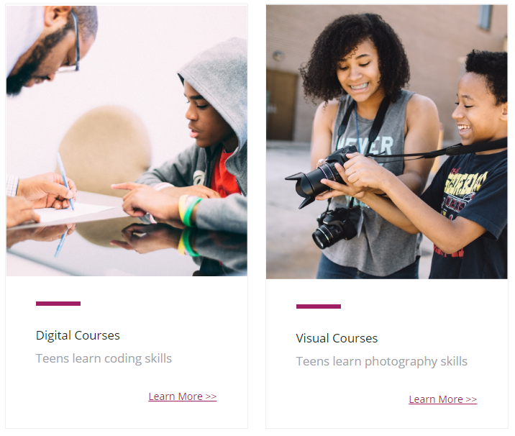
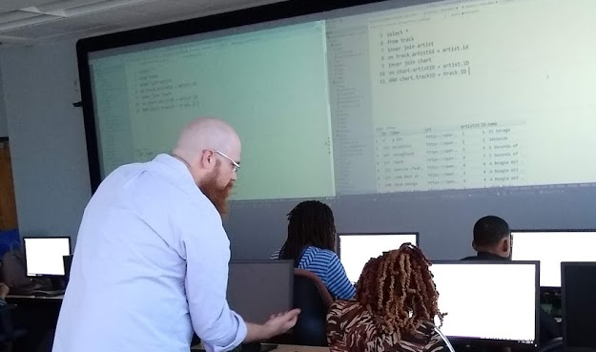
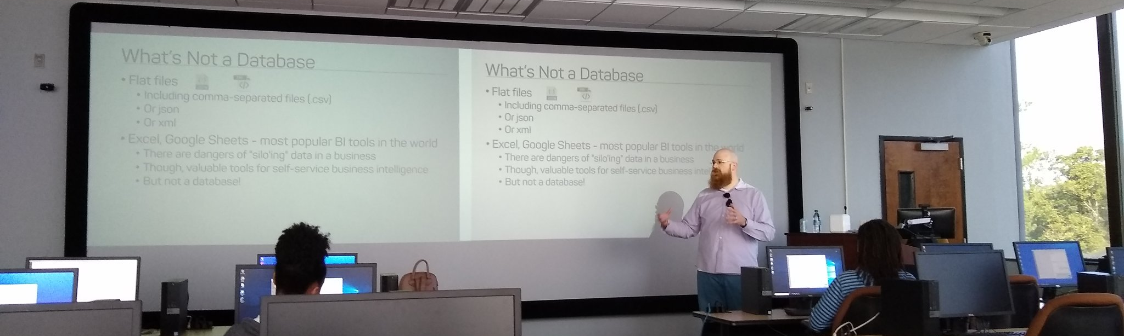
Support your Local STEM Initiatives
I encourage you to find, then donate time and money to local STEM education initiatives where you live. Get involved!
There is almost certainly some nonprofit where you live that needs your enthusiasm and skills to close the achievement gap.
https://www.thewallsproject.org/programs/futures_fund/

Slide 97
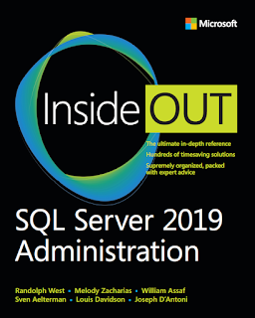
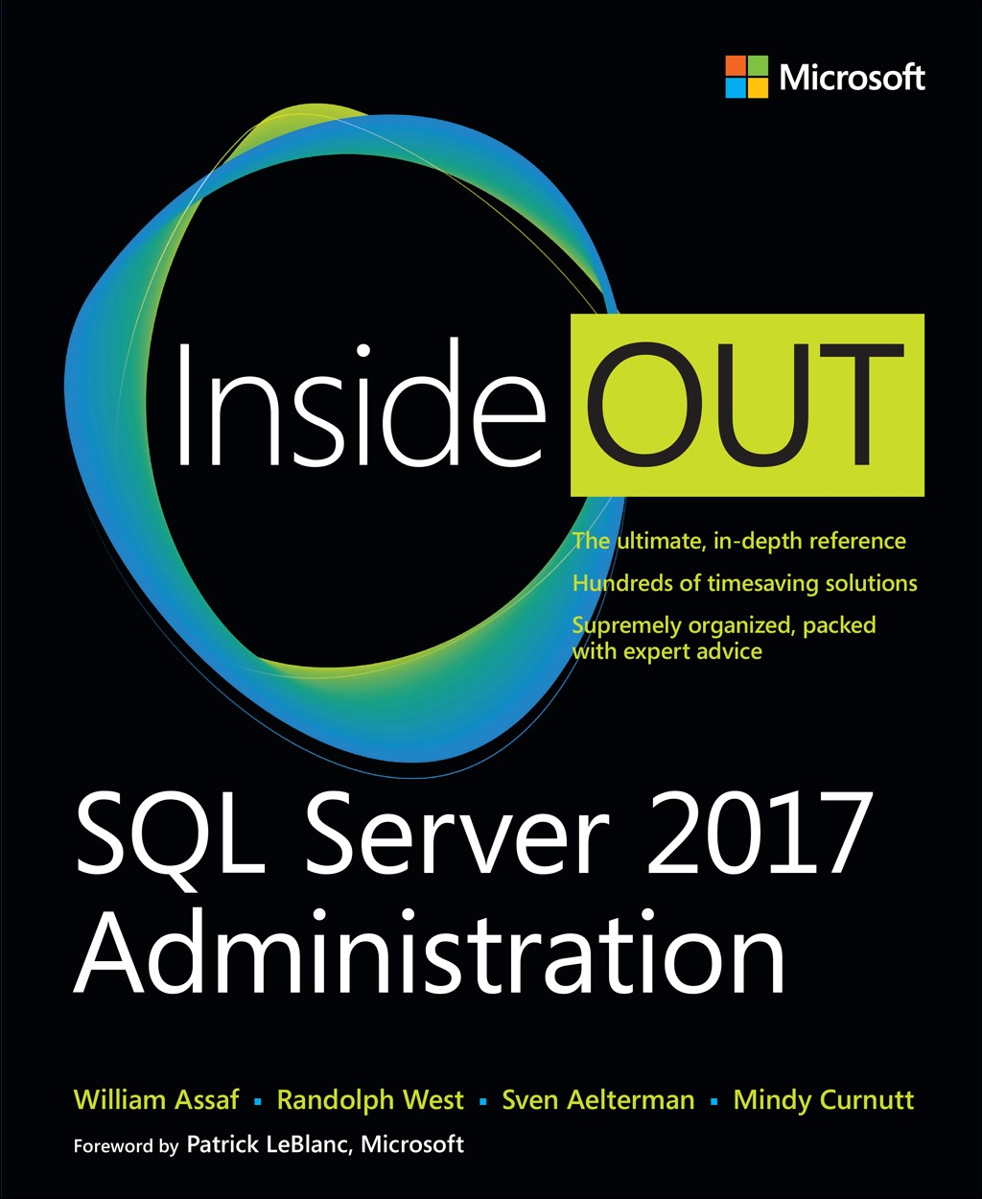
SQL Server 2017 Inside Out
SQL Server 2019 Administration Inside Out
by Microsoft Press
2017 published Feb 2018
2019 coming March 2020

Slide 98

Bio and contact
William D Assaf, MCSE
Baton Rouge SQL Server UG board
Principal Consultant, SQL Manager at Sparkhound
William.Assaf@sparkhound.com
Twitter: @william_a_dba
This presentation, including all source code, available at my blog:
SQLTact.com

Slide 99
UpCOMING EVENTS
Baton Rouge .NET UG
brdnug.org
Every 2nd Wednesday
Baton Rouge SQL Server UG
brssug.org
Baton Rouge Analytics and Intelligence Network
gobrain.org
Baton Rouge SQLSaturday
At LSU
March 7 – BI
August 1 – Everything
SQLSaturday.com
Activate Conference
At LSU
September 19 2020
ActivateConf.com

